Slide 1

Boolean Algebra and Computer Logic
Mathematical Structures for Computer Science
Chapter 8
Copyright © 2014 W.H. Freeman & Co. MSCS Slides Section 8.2

Slide 2
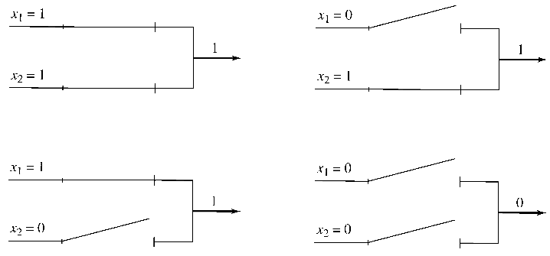
Basic Logic Elements
Imagine that the electrical voltages carried along wires fall into one of two ranges, high or low, which we will represent by 1 and 0, respectively.
Voltage fluctuations within these ranges are ignored, so we are forcing a discrete, indeed binary, mask on an analog phenomenon.
Also suppose that switches can be wired so that a signal of 1 causes the switch to be closed and a signal of 0 causes the switch to be open as seen in figure below.
Combine two such switches, controlled by lines x₁ and x₂, in parallel. The figure below illustrates the various cases. This circuit acts like disjunction (“or”) in propositional logic.
Solid State Switch
C
B
Transistor
E
Section 8.2
Logic Networks

Slide 3
Basic Logic Elements
Single Switch or Inverter Gate
+5v
R_{c}
Output
Example: Bipolar Technology
Logic 1 = 2V to 5V at Collector
Logic 0 = < 0.7V at Collector
Input x
R_{B}
B
C
Transistor Q₁
E
Gnd
Truth Table
Input Output
1 0
0 1
Section 8.2
Logic Networks

Slide 4
Basic Logic Elements
Dual Switch or NOR Gate
Example: Bipolar Technology
Logic 1 = 2V to 5V at Collector
Logic 0 = < 0.7V at Collector
+5v
+5v
R_{c}
R_{c}
Input x
R_{B}
B
C
C
B
Transistor Q₁
Transistor Q₂
R_{B}
Input y
E
Output
E
Gnd
Truth Table
Input x Input y Output
1 1 0
0 1 0
1 0 0
0 0 1
Section 8.2
Logic Networks

Slide 5
Basic Logic Elements
Dual Switch with Inverter Gate
Intel’s Stratix 10 has over 17 Billion Transistors on an Integrated Circuit – Largest Count Today, it is a FPGA
If another transistor stage is
added to the output what
does that make me?
Example: Bipolar Technology
Logic 1 = 2V to 5V at Collector
Logic 0 = < 0.7V at Collector
+5v
+5v
R_{c}
R_{c}
Input x
R_{B}
B
C
C
B
Transistor Q₁
Transistor Q₂
R_{B}
Input y
E
E
Gnd
+5v
Truth Table
Input x Input y Output
1 1 1
0 1 1
1 0 1
0 0 0
R_{c}
Output
R_{B}
B
C
Transistor Q₃
E
Gnd
What am I?
Section 8.2
Logic Networks

Slide 6
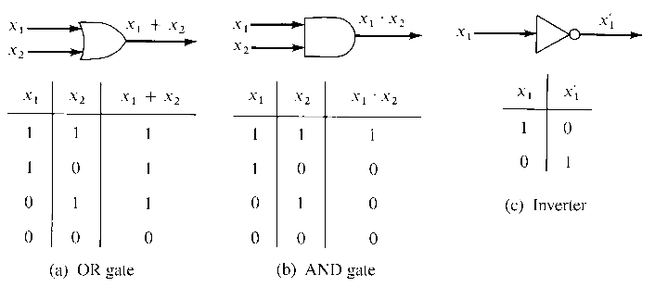
Basic Logic Elements
The OR gate, Figure (a), behaves like the Boolean operation +.
The AND gate, Figure (b), represents the Boolean operation •.
Figure (c) shows an inverter, corresponding to the unary Boolean operation ′ . Because of the associativity property for + and •, the OR and AND gates can have more than two inputs.
Section 8.2
Logic Networks

Slide 7
Boolean Expressions
DEFINITION: BOOLEAN EXPRESSION A Boolean expression in n variables, x₁, x₂, ... , x_{n}, is any finite string of symbols formed by applying the following rules:
  x₁, x₂, ... , x_{n} are Boolean expressions.
  If P and Q are Boolean expressions, so are (P + Q),
  (P • Q), and (P′).
x₃, (x₁ + x₂)′x₃, (x₁x₃ + x′₄)x₂, and (x′₁x₂)′x₁ are all Boolean expressions (omitting the • symbol).
In propositional logic, the logical connectives ∧, ∨, and ′ are instances of the operations of a Boolean algebra.
Section 8.2
Logic Networks

Slide 8
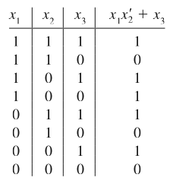
Truth Functions
DEFINITION: TRUTH FUNCTION A truth function is a function f such that f:{0,1}^{n}→{0,1} for some integer n ≥ 1. The notation {0,1}^{n} denotes the set of all n-tuples of 0s and 1s. A truth function thus associates a value of 0 or 1 with each such n-tuple.
Example: The Boolean expression x₁x′₂ + x₃ defines the truth function given in the table below:
Section 8.2
Logic Networks

Slide 9
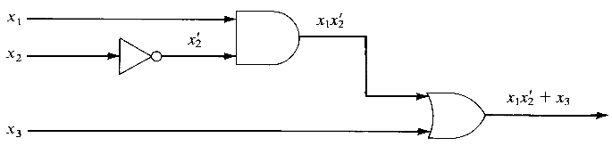
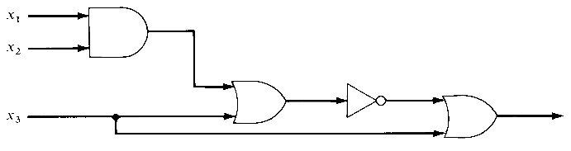
Networks and Expressions
By combining AND gates, OR gates, and inverters, we can construct a logic network representing a given Boolean expression that produces the same truth function as that expression.
Example: Logic network for Boolean expression x₁x′₂ + x₃ is shown in the figure below:
Example: Logic network for Boolean expression (x₁x₂ + x₃)′ + x₃ is shown in the figure below:
Section 8.2
Logic Networks

Slide 10
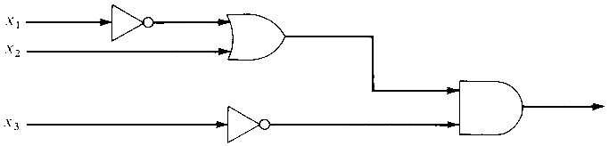
Class Exercise
Write a Boolean expression for the logic network in the figure below:
(x′₁ + x₂) x′₃
Section 8.2
Logic Networks

Slide 11
Combinational Networks
Logic networks constructed of AND gates, OR gates, and inverters are also called combinational networks.
Combinational networks have several features of note:
  Input or output lines are not tied together, except by passing through gates.
  Lines can be split, however, to serve as input to more than one device.
  There are no loops where the output of an element is part of the input to that same element.
  Finally, the output of a network is an instantaneous function of the input; there are no delay elements that capture and remember input signals.
    If this were not true you would get into a critical race.
    What is meant by critical race and how could it impact the combinational network?
Notice also that the picture of any network is, in effect, a directed graph.
Section 8.2
Logic Networks

Slide 12
Canonical Form
Arrows in the following statement indicate a procedure that we can carry out:
truth function ← Boolean expression ↔ logic network
We can write a unique truth function from either a network or an expression.
Given an expression, one can find a network with the same truth function. The converse is also true.
The last part of the puzzle concerns how to get from an arbitrary truth function to an expression (and hence a network) having that truth function.
Section 8.2
Logic Networks

Slide 13
Algorithm: Sum-of-Products
A sum-of-products expression to represent any truth function.
For this algorithm, the input is a truth table representing a truth function on n variables x₁, x₂, ... , x_{n}.
The output is a Boolean expression in disjunctive normal form with the same truth function.
A pseudocode description of the algorithm is given in the next slide.
Section 8.2
Logic Networks

Slide 14
Algorithm: Sum-of-Products
Sum-of-Products (truth table; integer n)
//the truth table represents a truth function with n arguments; //result is the canonical sum-of-products expression for this //truth function
Local variables:
sum //sum-of-products expression
product //single term in sum, a product
i //index for the columns of the table
row //index for the rows of the table
sum = empty
Simplest or standard form
Section 8.2
Logic Networks

Slide 15
Algorithm: Sum-of-Products
for row = 1 to 2^{n} do
if truth value for row is 1 then
initialize product;
for i = 1 to n do
if x_{i} = 1 then
put x_{i} in product
else
put x′_{i} in product
end if
end for
sum = sum + product
end if
end for
if sum is empty then
sum = x₁ x′₁
end if
write (“The canonical sum-of-products expression for this truth function is,” sum)
end Sum-of-Products
x₁ x₂ x₃ n = 3
0 0 0
0 0 1
0 1 0
0 1 1
1 0 0
1 0 1
1 1 0
1 1 1
Section 8.2
Logic Networks

Slide 16
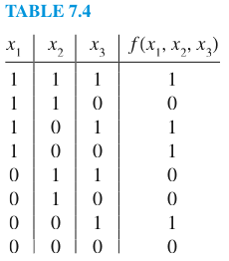
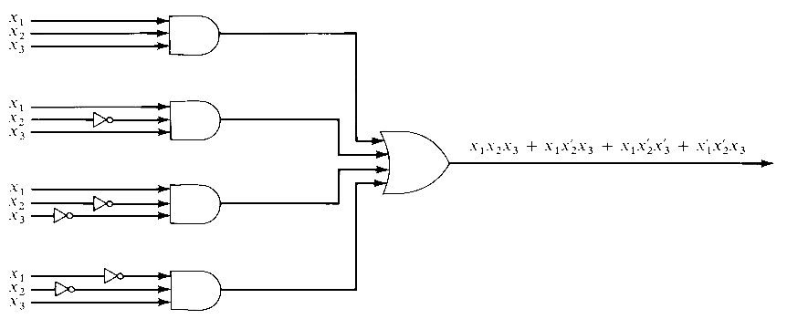
Example: Canonical Form
The network for the canonical sum-of-products form for the table shown below is shown in the figure below.
We have drawn the inputs to each AND gate separately because it looks neater, but actually a single x₁, x₂, or x₃ input can be split as needed.
Section 8.2
Logic Networks

Slide 17
Equivalent Boolean Expressions
DEFINITION: EQUIVALENT BOOLEAN EXPRESSIONS Two Boolean expressions are equivalent if they have the same truth functions.
The expressions
x₁x₂x₃ + x₁x′₂x₃ + x₁x′₂x′₃ + x′₁x′₂x₃ + x′₁x′₂x′₃ and
x₁x₃ + x′₂, for example, are equivalent Boolean expressions.
They share the same truth table.
Boolean algebra rules can be used to prove that these expressions are equivalent.
Section 8.2
Logic Networks

Slide 18
Boolean Algebra
Using the properties of Boolean algebra, we can reduce:
x₁x₂x₃ + x₁x′₂x₃ + x₁x′₂x′₃ + x′₁x′₂x₃ + x′₁x′₂x′₃ to x₁x₃ + x′₂
x₁x₂x₃ + x₁x′₂x₃ + x₁x′₂x′₃ + x′₁x′₂x₃ + x′₁x′₂x′₃
= x₁x₂x₃ + x₁x′₂x₃ + x₁x′₂x₃ + x₁x′₂x′₃ + x′₁x′₂x₃ + x′₁x′₂x′₃ (Idempotent property)
= x₁x₃x₂ + x₁x₃x′₂ + x₁x′₂x₃ + x₁x′₂x′₃ + x′₁x′₂x₃ + x′₁x′₂x′₃ (Communitive Property)
= x₁x₃(x₂ + x′₂) + x₁x′₂ (x₃ + x′₃) + x′₁x′₂ (x₃ + x′₃) (Distributive Property)
= x₁x₃•1 + x₁x′₂ •1 + x′₁x′₂ •1 (Complement Property)
= x₁x₃ + x₁x′₂ + x′₁x′₂ (Identity Property)
= x₁x₃ + x′₂x₁ + x′₂x′₁ (Commutative Property)
= x₁x₃ + x′₂ (x₁ + x′₁) (Distributive Property)
= x₁x₃ + x′₂ •1 (Complement Property)
= x₁x₃ + x′₂ (Identity Property)
Adding the same term does not change the outcome
Section 8.2
Logic Networks

Slide 19
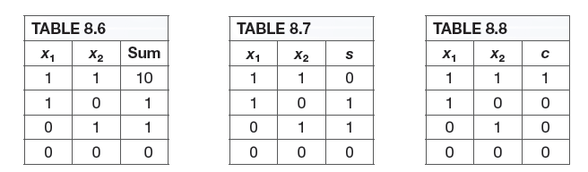
Useful Networks: Adder
Designing a network that adds binary numbers (Table 8.6), basic operation for a computer.
We can express the sum as a single sum digit s (the right-hand digit of the actual sum) together with a single carry digit c; this gives us the two truth functions of Tables 8.7 and 8.8, respectively.
The canonical sum-of-products form for each truth function is: s = x′₁x₂ + x₁x′₂
c = x₁x₂
An equivalent Boolean expression for s is:
s = (x₁ + x₂)(x₁x₂)′
Section 8.2
Logic Networks

Slide 20
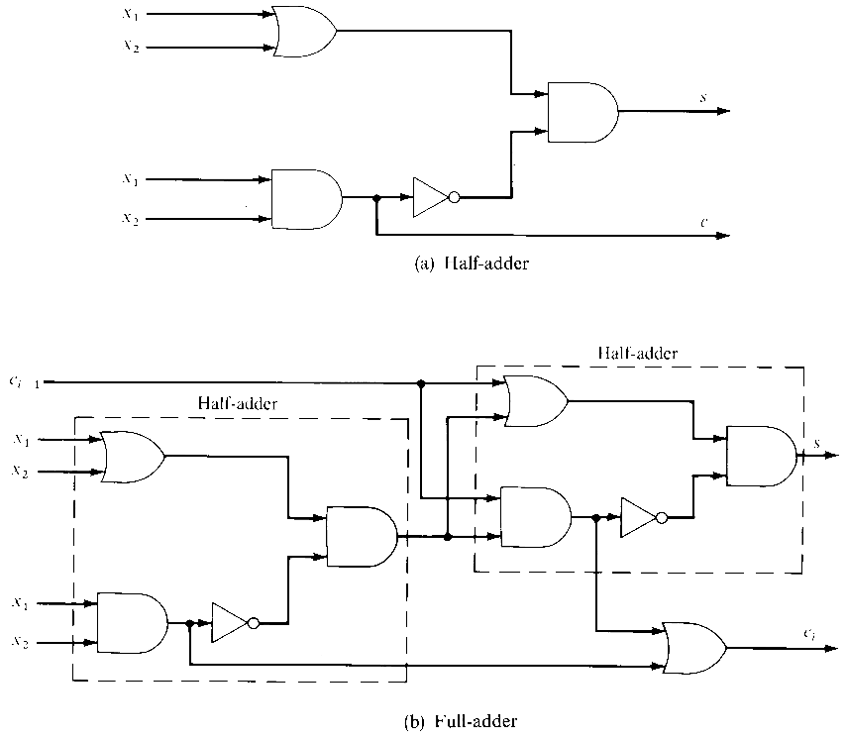
Half-Adder
Figure below shows a network with inputs x₁ and x₂ and outputs s and c. This device, for reasons that will be clear shortly, is called a half-adder.
Section 8.2
Logic Networks

Slide 21
Full-Adder
To add two n-digit binary numbers, we add column by column from the low-order to the high-order digits.
The i^{th} column (except for the very first column) has as input its two binary digits x₁and x₂ plus the carry digit from the addition of column i − 1 to its right.
A device is needed to incorporate the previous carry digit as input. This can be accomplished by adding x₁ and x₂ with a half-adder and then adding the previous carry digit c_{i - 1}(using another half-adder) to the result.
Again, a sum digit s and final carry digit c_{i} are output, where c_{i} is 1 if either half-adder produces a 1 as its carry digit. The full-adder is shown in the next slide.
Section 8.2
Logic Networks

Slide 22
Full-Adder
The full-adder is thus composed of two half-adders and an additional OR gate.
Section 8.2
Logic Networks

Slide 23
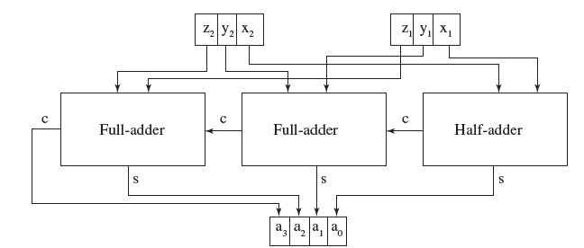
Adding two n-bit binary numbers
To add two n-bit binary numbers, the two low-order bits, where there is no input carry bit, can be added with a half-adder. The remaining bits are added with full adders. The figure below shows the modules required to add two 3-bit binary numbers z₁ y₁x₁ and z₂ y₂x₂.
Section 7.2
Logic Networks

Slide 24
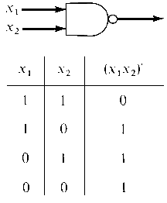
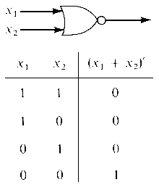
Other Logic Elements
The figure to the right shows the standard
symbol for the NAND gate
(the NOT AND gate) and its truth function.
The NOR gate (the NOT OR gate)
and its truth function appear
in this figure.
Section 8.2
Logic Networks

Slide 25
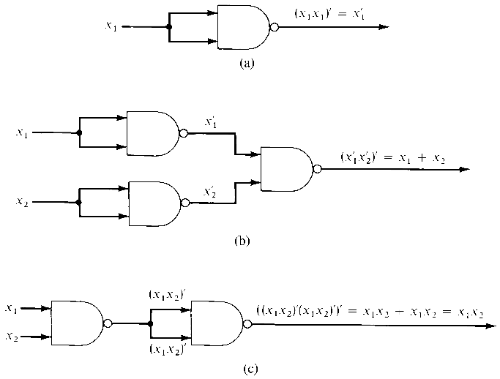
Other Logic Elements
The NAND gate alone is sufficient to realize any truth function because networks using only NAND gates can do the job of inverters, OR gates, and AND gates as seen in the figures (a), (b) and (c).
A NAND network for a
truth function can be
constructed by replacing
AND gates, OR gates, and
inverters in the canonical
form or a minimized form
with the appropriate NAND
networks, but one can often obtain a simpler network by
using the properties of NAND elements directly.
http://www.ti.com/design-tools/webench-power-design/fpga-power-architect.html
Section 8.2
Logic Networks

